Slide 1
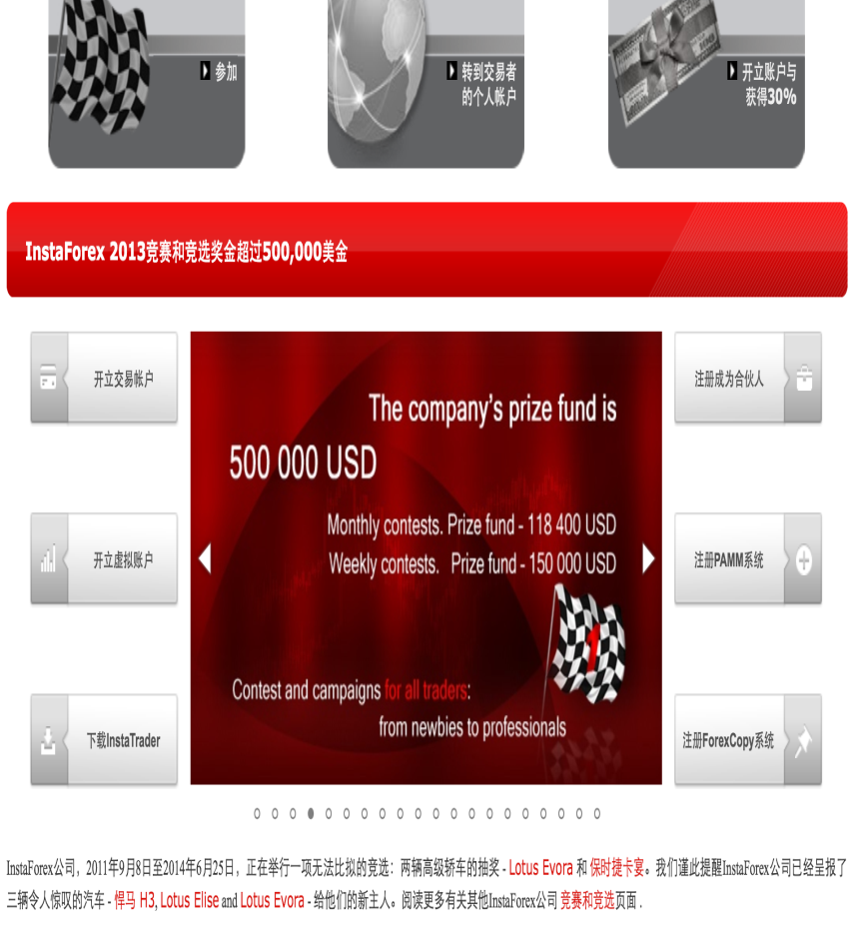
How open account at InstaForex
1. Open trading account
2. (a)STATUS: individual
(b) Fill in email add
https://secure.instaforex.com/en/open-account

Slide 2
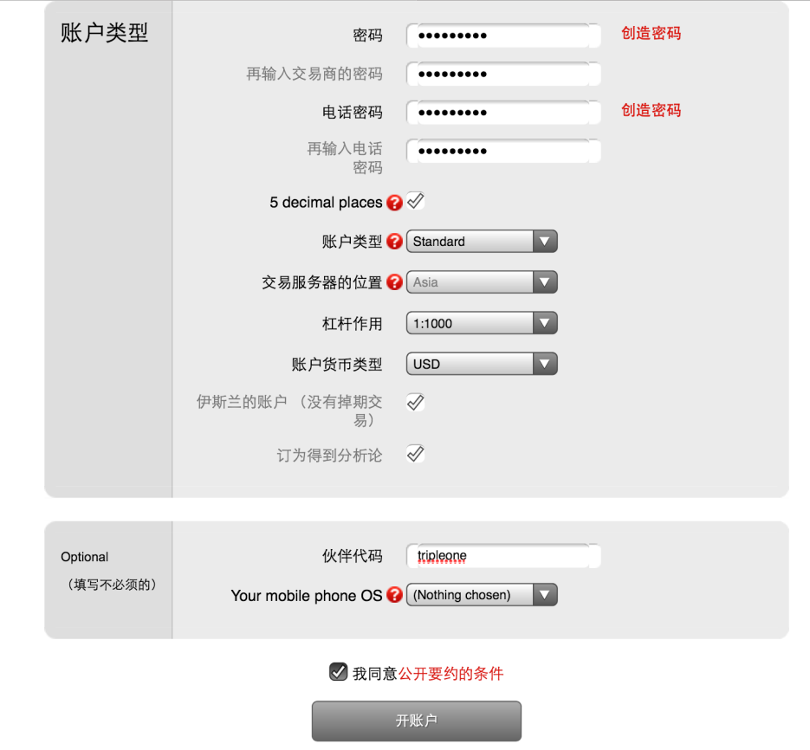
3. Fill in personal detail
4. (a) must tick all columm
(b) p/w and h/p can be same
(c) Partner cod : tripleone

Slide 3
5. Record in your note
Sent below info to us to link your account to M2 system

